Slide 1
Tokyo 2020 Olympics Data analysis

Slide 2
introduction
The Tokyo 2020 Olympics, held in 2021 due to the COVID-19 pandemic, featured athletes from around the globe competing in a diverse array of sports. This report aims to provide an in-depth analysis of the Olympic data, focusing on medal distribution, country performance, and sport-specific insights. The analysis leverages data collected from various sources, including official Olympic databases and sports analytics platforms.

Slide 3

Data source and web scrapping technique:
Datasource was official olympics website : https://olympics.com/en/olympic-games/tokyo-2020/athletes
Scarping done by

Slide 4
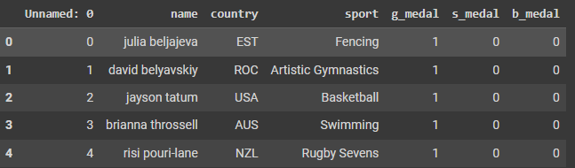
Data description
Unnamed: 0: An index or identifier column that may have been automatically generated during data scraping or loading. This column is not used for analysis and can be ignored or removed.
name: The name of the athlete who competed in the Olympics. This helps identify the individual performances.
country: The country that the athlete represents. This column allows for aggregation and analysis of performance by country.
sport: The sport in which the athlete competed. This information is used to categorize medal counts and performance metrics by sport.
g_medal: The number of gold medals won by the athlete. This column indicates the athlete's top performance in their event.
s_medal: The number of silver medals won by the athlete. This column reflects the athlete's second-place finishes.
b_medal: The number of bronze medals won by the athlete. This column shows the athlete's third-place achievements.
Overview of the Data:
Total Records: The dataset contains a record for each athlete's medal performance, capturing a comprehensive view of Olympic results.
Scope: Includes data for all athletes who won medals at the Tokyo 2020 Olympics, covering a wide range of sports and countries.
Granularity: Provides individual-level detail on medal counts, allowing for both athlete-specific and aggregate analyses.

Slide 5
Methodology
Feature engineering
Creation of New Features:
Medal score system:applied weighted point system
Caluculating total number of medals
Dataframe transformation :
The transformation into separate DataFrames allows for easier aggregation and analysis. By splitting the data into country-level and sport-level metrics, we can more effectively analyze performance across different dimensions
Data cleaning
Handling Missing Values
Data Validation: Ensured data entries were accurate and consistent with the official records.
Ensuring there is no duplicated values
Unusual Values Identification
,

Slide 6
More details about data transformation
DataFrame 1: Country-Level Metrics
country: Name of the country.
number_of_sports: Number of sports in which the country participated.
total_medals: Total number of medals won by the country.
total_medal_score: Weighted score based on the medals won (calculated using a predefined point system).
best_sport: The sport in which the country performed the best.
num_athletes: Number of athletes representing the country.
DataFrame 2: Sport-Level Metrics
Sport:name of sport
Total_medals_per_sport:Total number of medals awarded in each sport
Country_with_most_gold_medals : Country with the most gold medals in each sport.

Slide 7
In Summary: By processing the original data into these two DataFrames, we improve the clarity and usability of the data. This transformation supports more detailed and insightful analysis, allowing for a comprehensive evaluation of Olympic performance both at the country level and the sport level.
Voice modulation
This is a powerful tool in public speaking. It involves varying pitch, tone, and volume to convey emotion, emphasize points, and maintain interest:
Pitch variation
Tone inflection
Volume control

Slide 8
Analysis Results
Country with the Highest Number of Athletes
Country: USA
Number of Sports: 27
Total Medals: 291
Total Medal Score: 1024
Best Sport: Swimming
Number of Athletes: 254
2-Country with the Lowest Number of Athletes
Country: BRN (Bahrain)
Number of Sports: 1
Total Medals: 1
Total Medal Score: 3
Best Sport: Athletics
Number of Athletes: 1

Slide 9
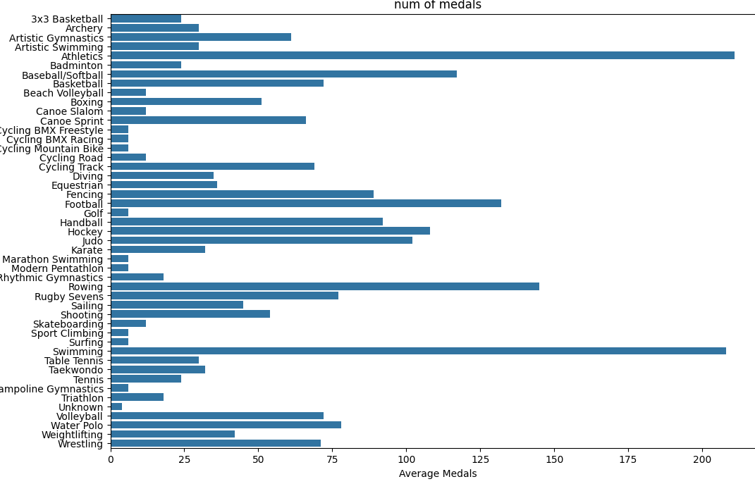
Sports with highest number of medals are: 1-Athletics 2-Swimming 3-Rowing 4-Football 5-Baseball

Slide 10
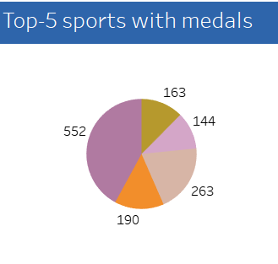
Sports with most gold medals: 1-swimming 2-fencing 3-Handball 4-Baseball 5-Diving

Slide 11
THANK YOU
Team 1
Shahed Hisham
Ahmed Ashraf

